Slide 1
Phishing Awareness Training Understanding & Preventing Online Fraud
Presented by
Nupoor Bande

Slide 2
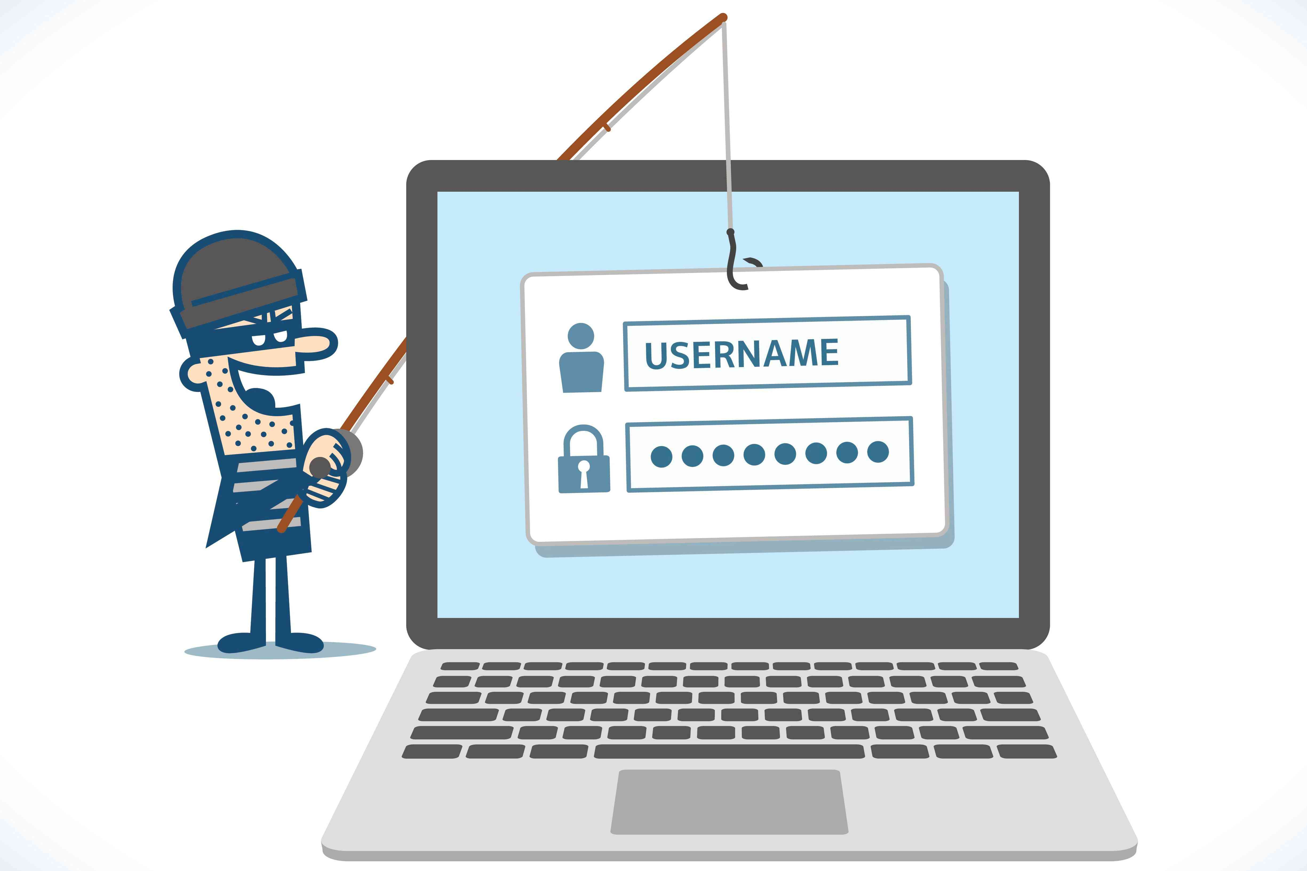
What is Phishing?
Phishing is a cyber attack where attackers try to:
Trick people into sharing sensitive information
Steal passwords, banking details, or personal data
Spread malware through fake messages
Attackers pretend to be trusted sources like:
Banks
Social media platforms
Companies
Government organizations

Slide 3
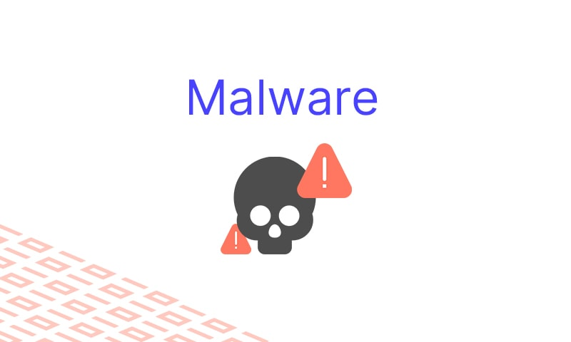
Why Phishing is Dangerous
Phishing can lead to:
Financial loss
Identity theft
Account hacking
Data leakage
Malware infections

Slide 4
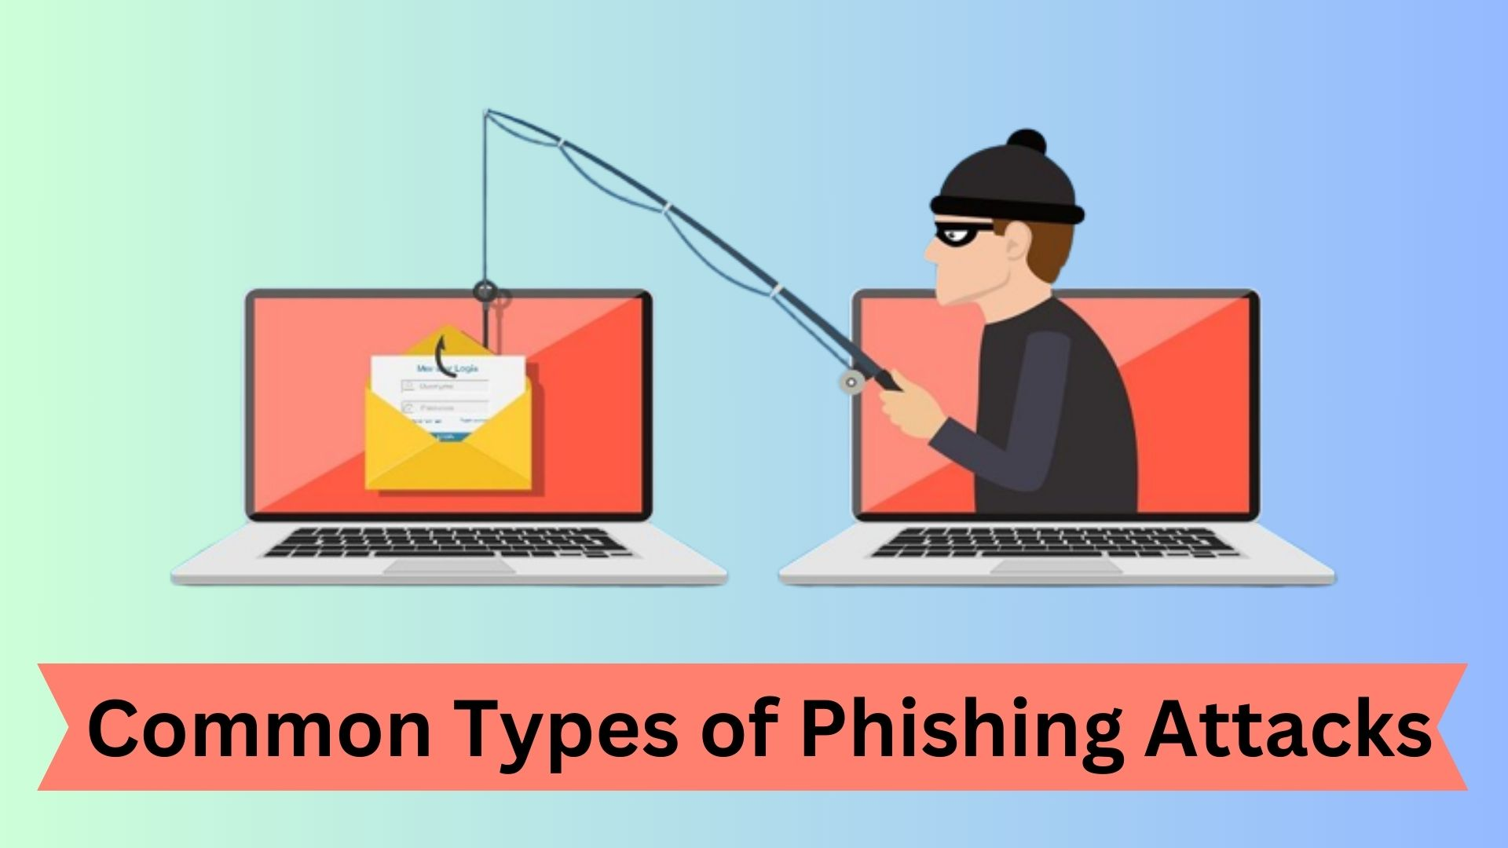
Types of Phishing Attacks
Email Phishing
Fake emails pretending to be legitimate.
Spear Phishing
Targeted attacks on specific individuals.
Smishing
Phishing through SMS messages.
Vishing
Phishing using phone calls.

Slide 5
How Phishing Works
Attacker creates fake message or website
Sends link or attachment
Victim clicks link
Victim enters sensitive information
Attacker steals data

Slide 6
How to Recognize Phishing Emails
Look for:
❌ Unknown sender
❌ Spelling or grammar mistakes
❌ Urgent or threatening messages
❌ Suspicious links
❌ Requests for passwords or OTP

Slide 7
How to Identify Fake Websites
Check for:
✅ HTTPS security
✅ Correct domain name
✅ Professional design
✅ Valid contact information

Slide 8
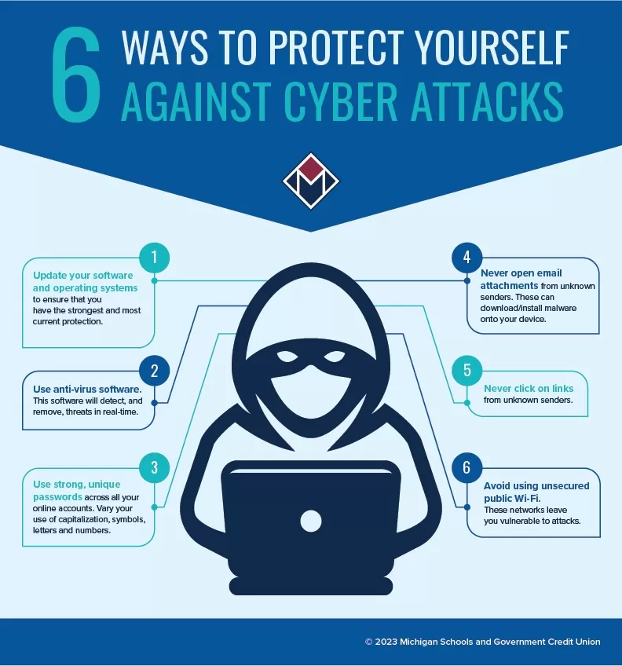
Best Practices to Stay Safe
✔ Never share passwords or OTP
✔ Verify sender before clicking links
✔ Use strong passwords
✔ Enable two-factor authentication
✔ Avoid downloading unknown attachments
✔ Keep software updated

Slide 9
Real-World Phishing Examples
Example 1:
Fake bank SMS asking for account verification
Example 2:
Fake Instagram login page stealing passwords
Example 3:
Job scam emails asking registration fees.

Slide 10

Interactive Quiz
Q1. Which is a sign of phishing?
A) Correct spelling
B) Urgent request for password
C) Official domain name

Slide 11
Q2. What should you check before clicking a link?
A) Sender email
B) Website URL
C) HTTPS security
D) All of the above

Slide 12
Q3. Should you share OTP with bank officials?

Slide 13

Tools That Help Detect Phishing
Email spam filters
Antivirus software
Browser security alerts
Cyber awareness training

Slide 14
THANKYOU !

